Slide 1
Performance Metrics in Classification

Slide 2
Contents
Confusion Matrix
FPR (Type 1 Error)
FNR (Type 2 Error)
Recall (TPR, Sensitivity)
Precision (Positive Prediction value)
Accuracy
F Beta (F1 Score)
ROC Curve, AUC Score

Slide 3
Classification problem
Classification problem can be solve using class labels or probability
In class labels (A or B) I need to set threshold default = 0.5
In Probability mainly proper threshold value need to be set. (may be 0.3 or 0.6).
Based on the output two problem statement are there
I have 1000 records in that 500 yes and 500 no
600 yes and 400 no
700 yes and 300 no
All these are balanced data
Suppose if we have 800 yes and 200 no then it is a imbalanced data (bias)
If balanced data – Accuracy
If imbalanced data – recall, precision, F1 score

Slide 4

Confusion Matrix
Imbalanced Data
900- A and 100-B
Recall (TPR) = TP / TP+FN (out of total actual positive values, how many values did we predicted correctly)
Precision = TP / TP+FP (out of total predicted positive results, how many values are positive)
Eg : Spam detection (precision – whenever FP is much more important )
Cancer or not – whenever FN is important – Recall
F Beta (if FP and FN need to check)
FP is important beta = 0.5
If FN is important beta = 2
 | Actual values
Predicted Values |  | 1 | 0
 | 1 | TP | FP
 | 0 | FN | TN
FP – Type 1 error (FPRate) FP / FP+TN
FN – Type 2 error(FN Rate)
Always we need to reduce these error
TP and TN are correct values (Accurate Results)
Accuracy = TP +TN / TP+FP+FN+TN (if balanced data)

Slide 5
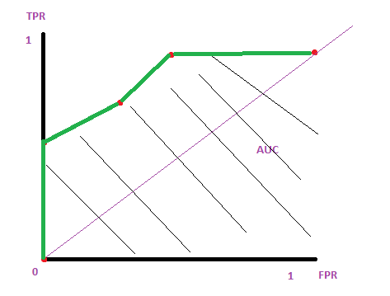
ROC (Receiver Operating Characteristic curve) and AUC (Area Under Curve) (Binary Classification problems) threshold(0,0.2,0.4,0.6,0.8,1)
Y | Y(pred) | Y(0) | Y(0.2) | Y(0.4) | Y(0.6) | Y(0.8) | Y(1)
1 | 0.8 | 1 | 1 | 1 | 1 | 0 | 0
0 | 0.96 | 1 | 1 | 1 | 1 | 1 | 0
1 | 0.4 | 1 | 1 | 0 | 0 | 0 | 0
1 | 0.3 | 1 | 1 | 0 | 0 | 0 | 0
0 | 0.2 | 1 | 0 | 0 | 0 | 0 | 0
1 | 0.7 | 1 | 1 | 1 | 1 | 0 | 0
(TPR, FPR) |  | (1,1) | (1,0.5)
Y(0)
TPR = TP / TP+FN
FPR = FP/FP+TN
TPR = 4 / 4+0 = 1
FPR = 1/1+1 = 0.5
FN : 1→0
FP : 0→ 1
TN : 0 → 0
TP : 1 -> 1
TP = 4
FP = 1
TN = 1

